Slide 1
Creating Mastery with a Greater Depth Lesson
Problem Solving and Reasoning

Slide 2
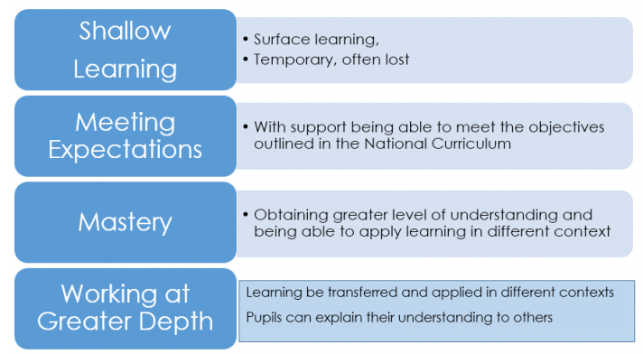
Reasoning is a very important part of the new end of KS expectations.
What has the child already accomplished and how can they now apply this to other situations? By doing this, it will allow them to explain and reason.

Slide 3
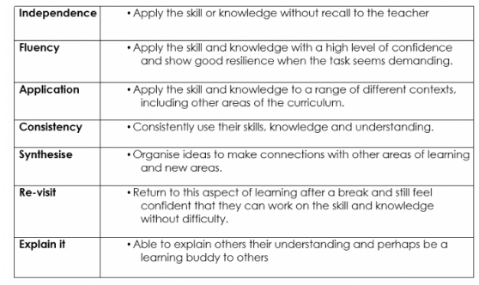
Mastery is not:
• Mastery and greater depth – not working on content from the next year group.
• Mastery and greater depth in mathematics – not practising the same concept with bigger numbers.

Slide 4
Thinking about rich tasks, problem-solving and higher-order thinking skills
tasks are worked on rather than just worked through
questions are asked genuinely to find out what students are thinking rather than to illicit responses that we are on the look out for
students think their own thoughts and assess their own understanding without trying to guess what is in their teachers’ mind

Slide 5
Thinking about rich tasks, problem-solving and higher-order thinking skills
Rich tasks open up mathematics. They transform the subject from a collection of memorised procedures and facts into a living, connected whole. Rich tasks allow the learner to 'get inside' the mathematics. The resulting learning process is far more interesting, engaging and powerful; it is also far more likely to lead to a lasting assimilation of the material for use in both further mathematical study and the wider context of applications.
Current research evidence indicates that students who are given opportunities to work on their problem solving skills enjoy the subject more and are more confident.

Slide 6
Thinking about rich tasks, problem-solving and higher-order thinking skills
Rich tasks can enable students to work mathematically by allowing them to:
Step into activities even when the route to a solution is initially unclear
Get started and explore because the tasks are accessible to pupils of wide ranging abilities
Pose as well as solve problems, make conjectures
Work at a range of levels
Extend knowledge or apply knowledge in new contexts
Work successfully when using different methods
Broaden their problem-solving skills
Deepen and broaden mathematical content knowledge
See and make sense of underlying principles or make connections between different areas of mathematics
Work within include intriguing contexts
Observe other people being mathematical or see the role of mathematics within cultural settings

Slide 7
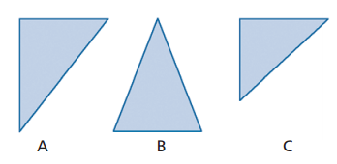
Thinking about rich tasks, problem-solving and higher-order thinking skills
Which one might be the odd one out and why?

Slide 8
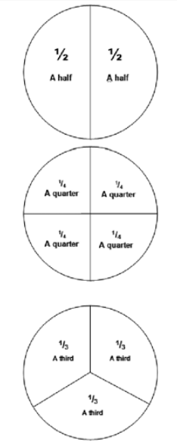
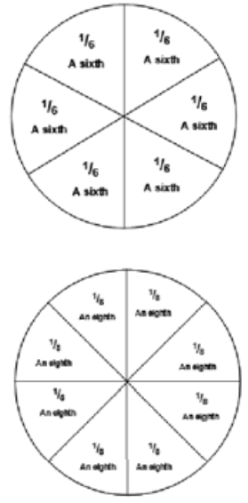
“Sort out these fractions in ways that produce as many whole circles as you can”. Record what you are finding as you go along.

Slide 9

“Can you see the following fractions in this diagram
2/5 of something? (What’s the something and where is the 2/5?)
3/5 of something? (What’s the something and where is the 3/5?)
5/2 of something? – etc...
5/3 of something?
2/5 of 5/3 of something?
3/5 of 5/3 of something?
1 ÷ 3/5 of something?

Slide 10
Place Value rich tasks
Bowls of fruit are put out that each contain 10 pieces of fruit. A number of two-digit numbers on the board represent how many pieces of fruit are in larger boxes, e.g. 25 apples. Working in pairs, the children figure out how many full bowls of 10 pieces of fruit can be made from the larger boxes, and how many pieces will be left over. In the second part of the lesson, put the children’s solutions up on the whiteboard, and holds a class discussion: what do pupils notice about how many items of fruit there are in total, the number of bowls that can be made from these, and the number of leftovers?

Slide 11
Place value rich tasks
A mystery two-digit number contains just one six. What number might it be?
Materials: 1-100 number grid or single-digit number cards (optional).
Help the children to explore the possibilities systematically. Discuss with them how they might record their responses.
Extension activities:
1) Find the set of two-digit numbers:
- which contain a different single digit such as 4
- which has both digits the same, or
- where the first digit is more than 6 and the second digit is less than 5
2) Using only 7, 4 and 9 how many different three-digit numbers can you make? Write them down here.
Extension activity:
1) Find the set of three-digit numbers which:
- contain three digits that are the same
- have two 3’s and another digit greater than 3.

Slide 12
Place value rich tasks
- What numbers can you make that are below 100 and have 7 in the tens place?
- I am thinking of a number between 10 and 100 with a single 8 in it. What might the number be?
- What do you know and what can you find out about the number 190?
- What numbers can you make using 4, 7 and 9?
- What numbers can be rounded off to 20?
- How many three-digit number plates can you make or find with 4 in the hundreds place?
- Using base 10 materials how many ways can you model the number 25?

Slide 13
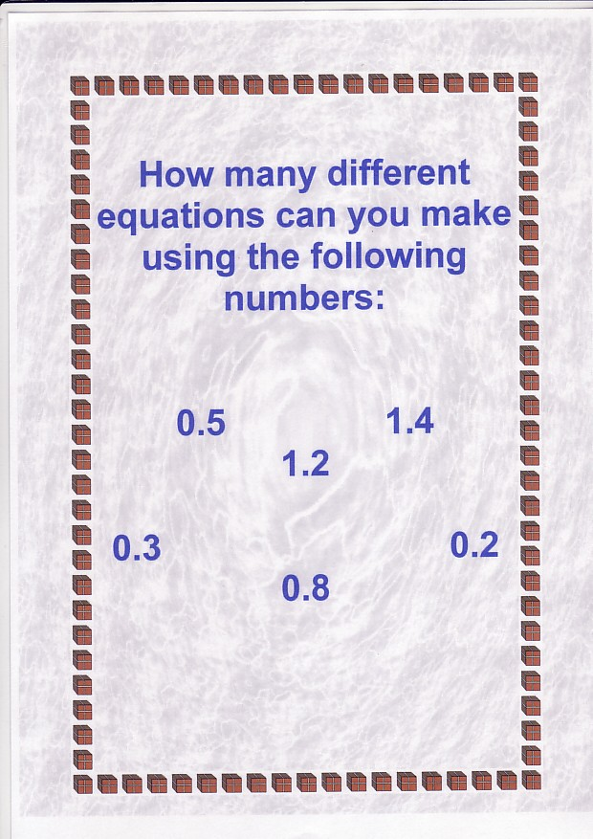
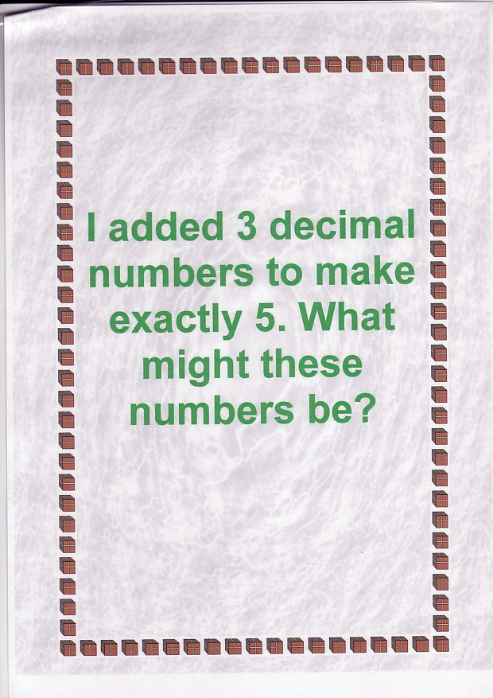
Place value rich tasks
- How many numbers can you make using 1, 0, 3, 7, 8 and 6?
- Represent 348 in as many different ways as you can?
- Two numbers multiply to give 36,000. What might the two numbers be?

Slide 14
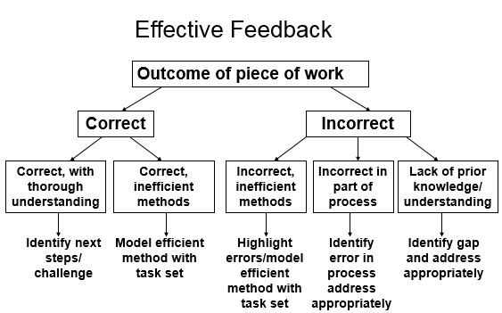

Slide 15
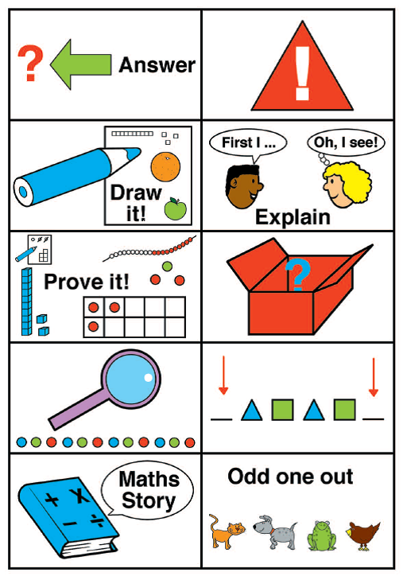
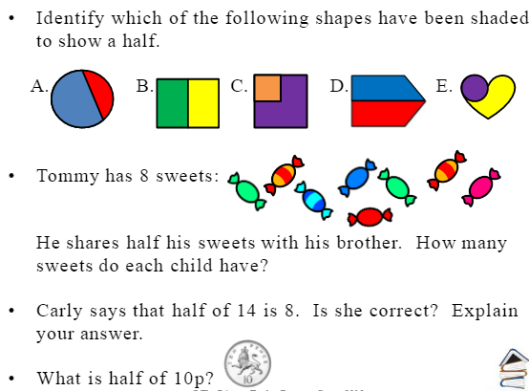
We should check always check pupils’ work for ‘slips’ and errors that reflect a lack of understanding and pupils should be encouraged to respond through further practice where needed. This ensures that marking is always meaningful, manageable and motivating – designed to enhance pupil performance and deepen understanding.
Examples of next steps to give: Year 1

Slide 16
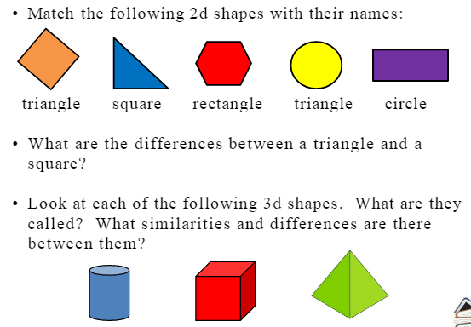

Slide 17
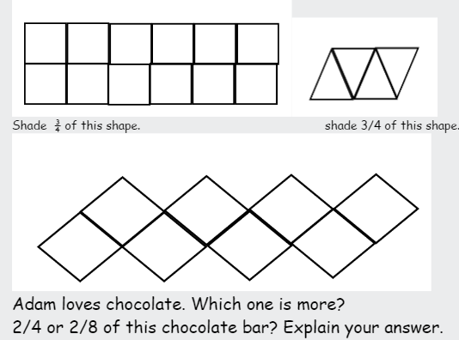

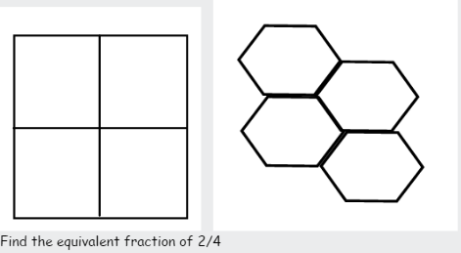
Year 2:
½ of ? = 17
Which is the odd one out:
½ of 20, 1/3 of 30 or ¼ of 18
If ½ of 20 = 10 and ½ of 22 = 11, what is half of 21? Explain.
Can you complete your own with
4 numbers which are all different.

Slide 18
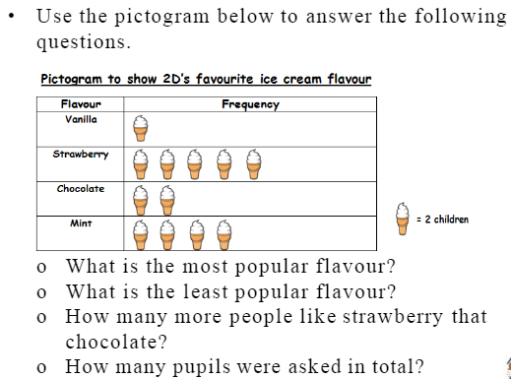
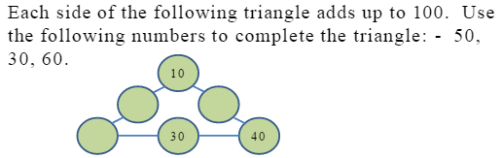
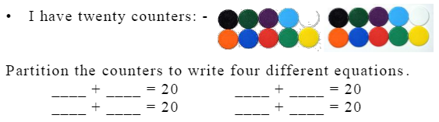
Create your own question based on the pictogram to give to a friend.

Slide 19
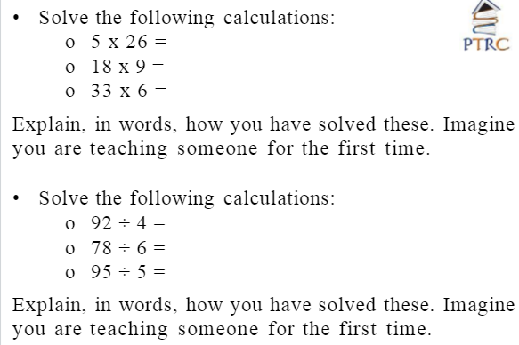
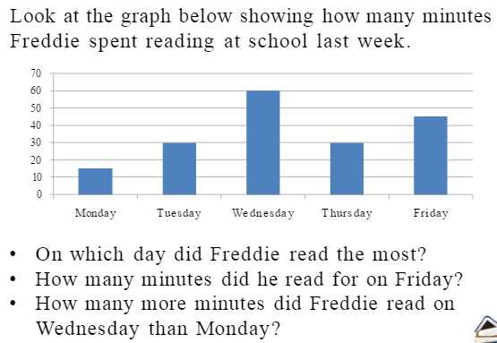
Year 3

Slide 20
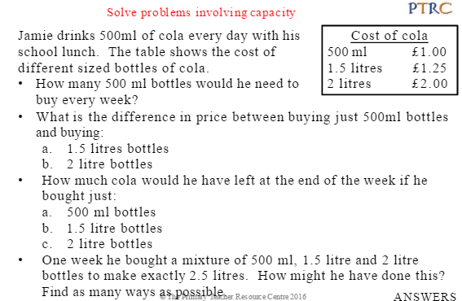
Year 4

Slide 21
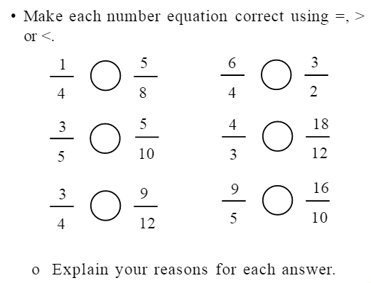
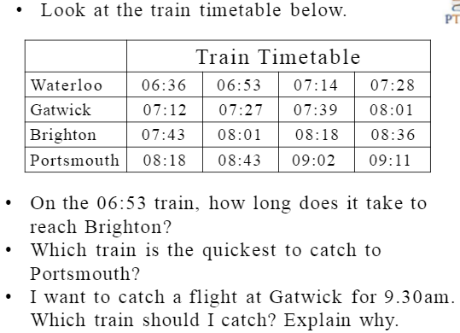
Year 5

Slide 22
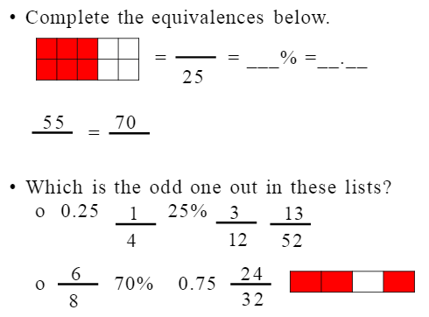
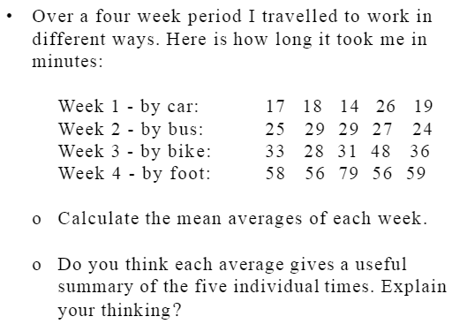
Year 6

