Slide 1
DYNASTY 18
By Aaron Noah Lilly

Slide 2
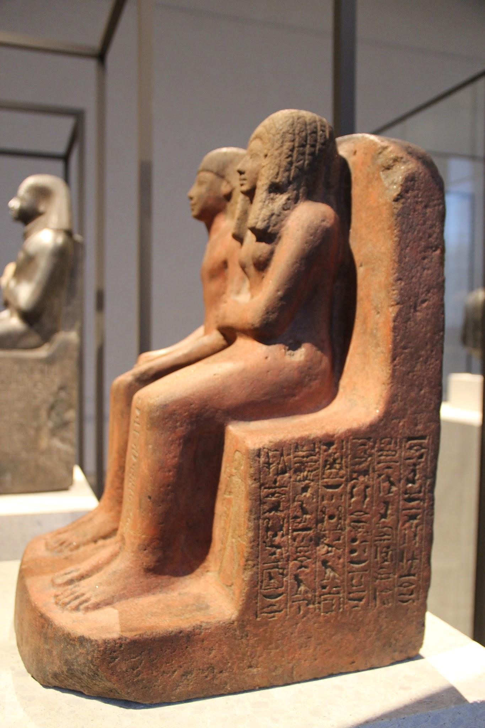
How did it start?
Dynasty 18 was founded by Ahmose the brother or son of the last ruler of the 17th Dynasty kamose it was founded in the year 1550 Bc and ended in 1292 Bc

Slide 3
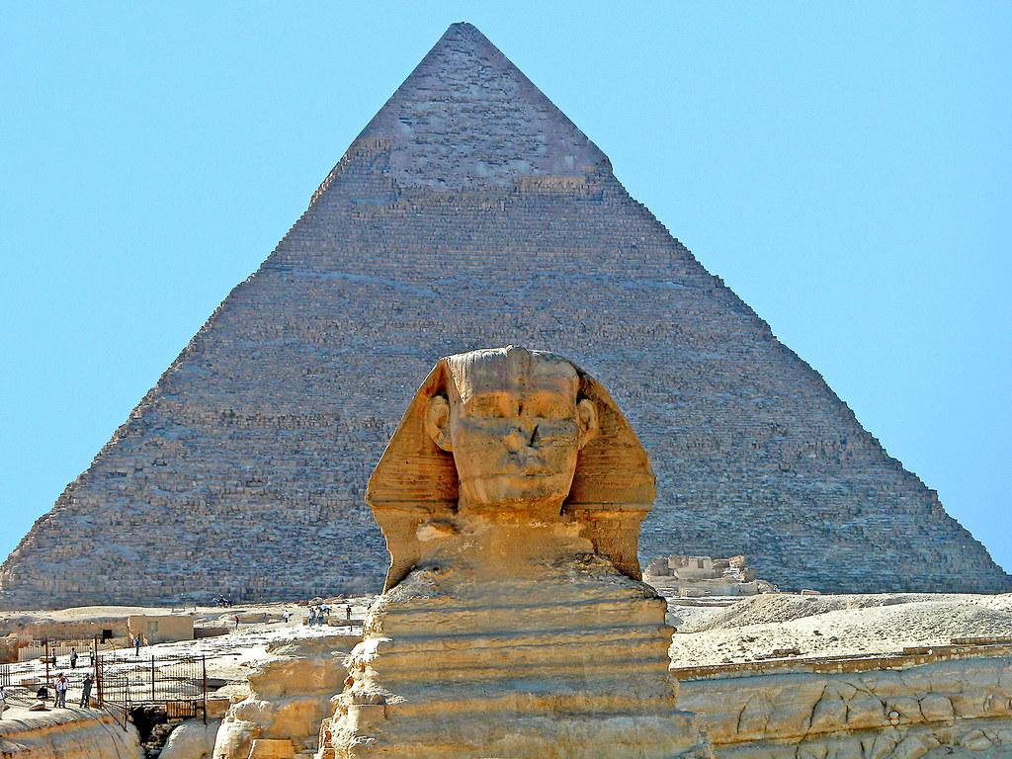
The pharaohs
There was many pharaohs in this time period the first one Ahmones Amenhoptp
Thutmose Thutmose II Thutmose III hatshpsut hatshpsut II those are only some of the Pharaohs

Slide 4
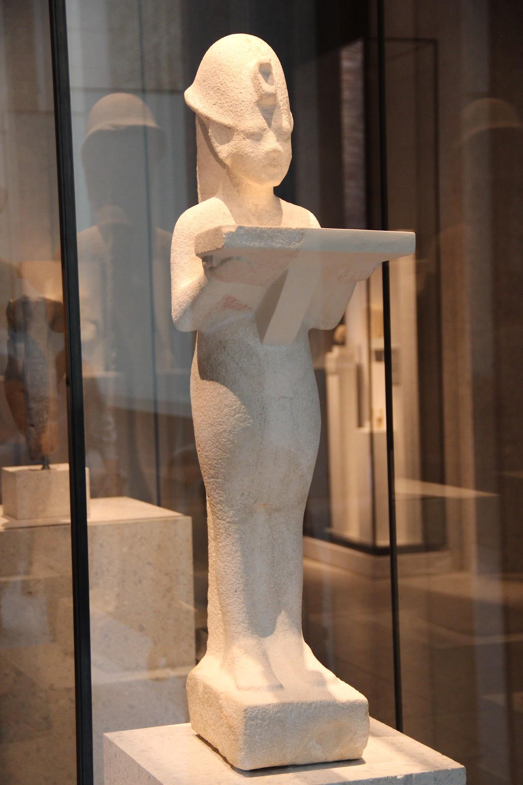
RELATIONS
They had a good relationship with the nubia and a few neighbouring tribes

Slide 5
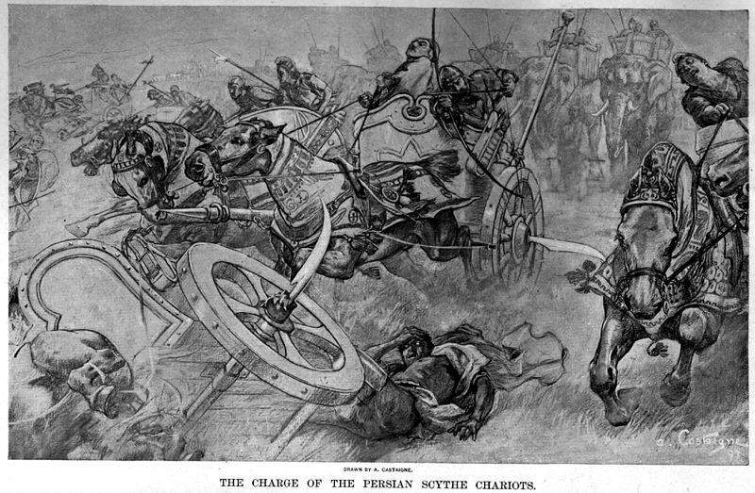
WAR
They were known for their military gains the time period was nicknamed the golden age alot from the miltary gains the pharaohs had about 600 chariots to there names and even more on the ground

Slide 6

Thank you
Thanks for listening bye bye

