Slide 1
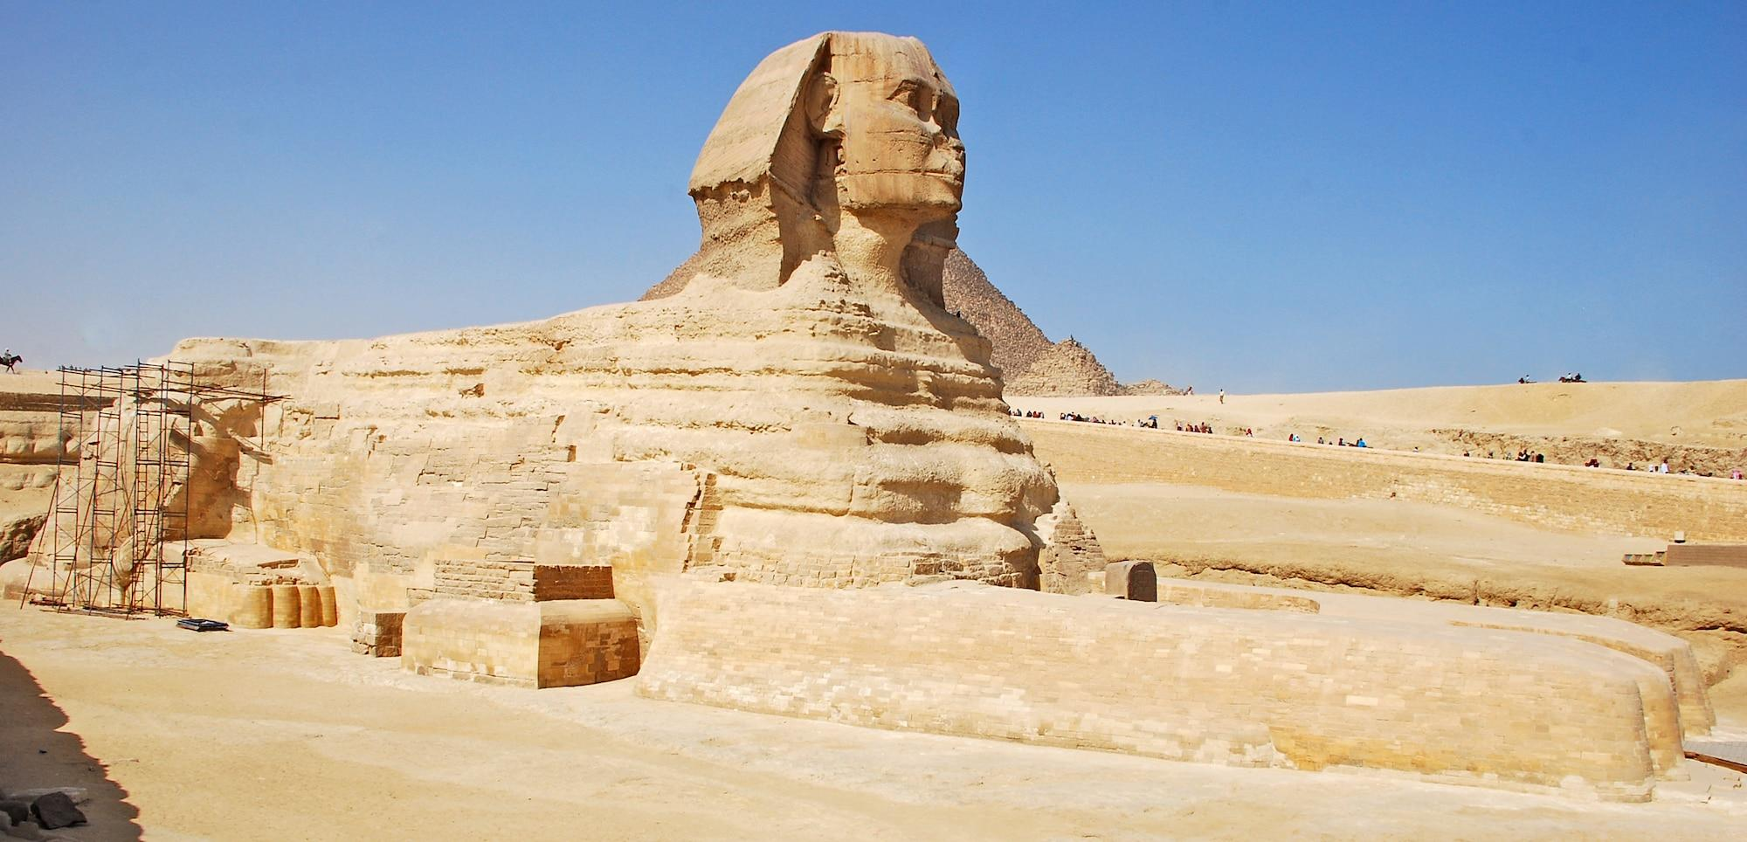
Dynasty 4
By summer ,Jessica ,Cayden,Tommy Alfie, Noah P

Slide 2
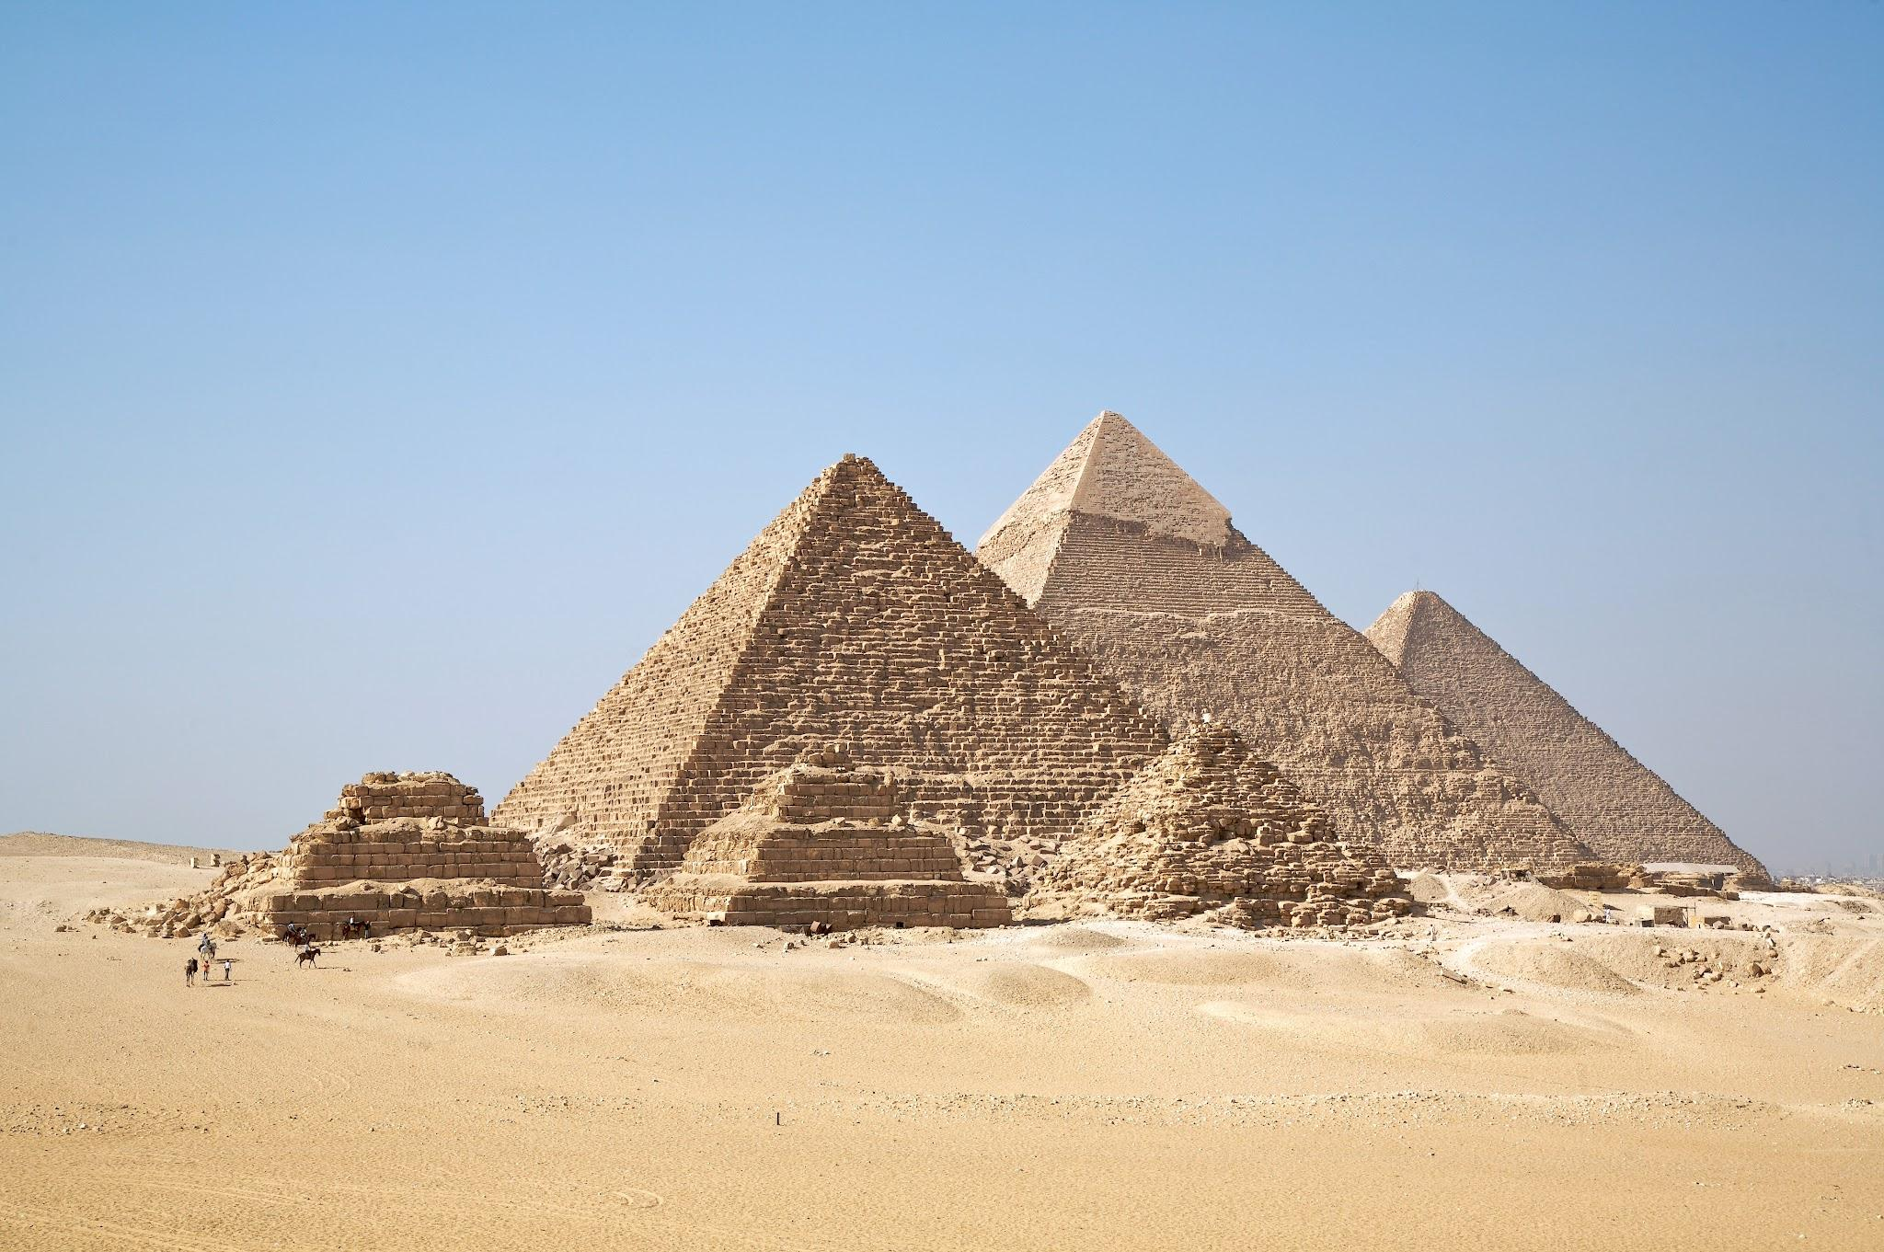
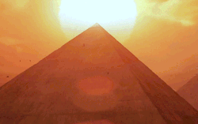
Old kingdom
The old kingdom is the name for
Egypt during the 3rd millennium BC.
It was the first of three so called
Kingdom periods.

Slide 3
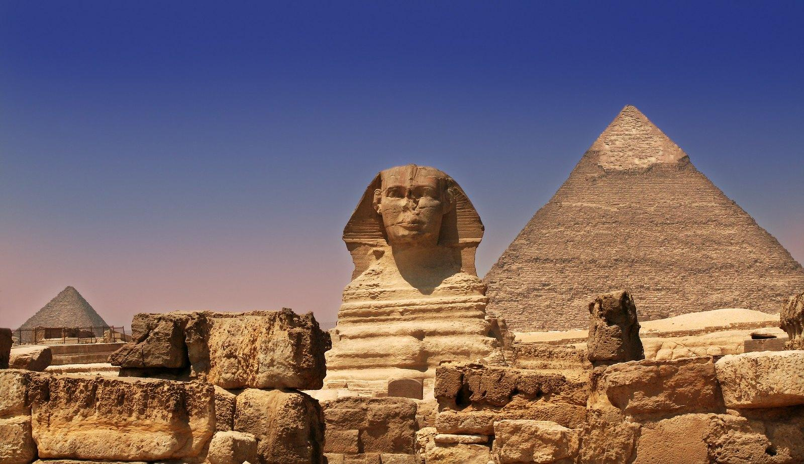
The dynasties can be grouped into distinct periods
Early dynasty period (1-2)
Old kingdom(3-6)
First intermediate period(7-10)
Middle kingdom(11-14)
Second intermediate period (15-17)

Slide 4
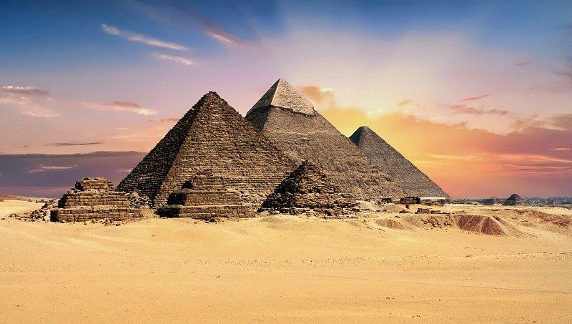
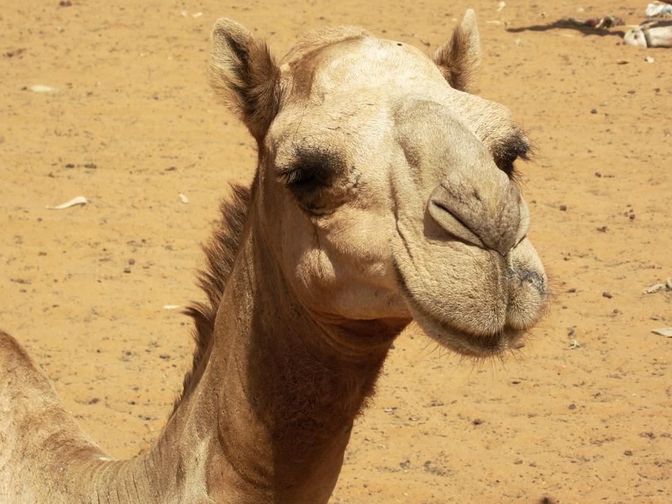
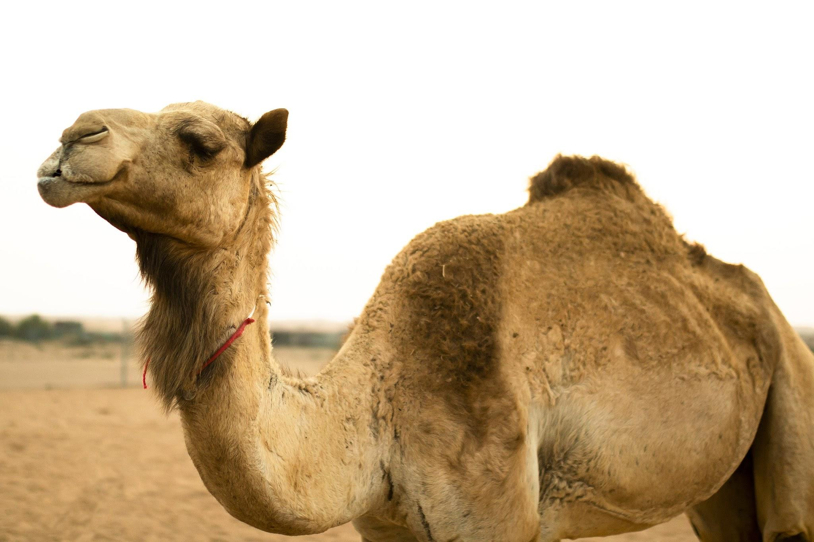
Old kingdom
Old kingdom was the best by the third dynasty through to the sixth dynasty

Slide 5




Thank you

