Slide 1
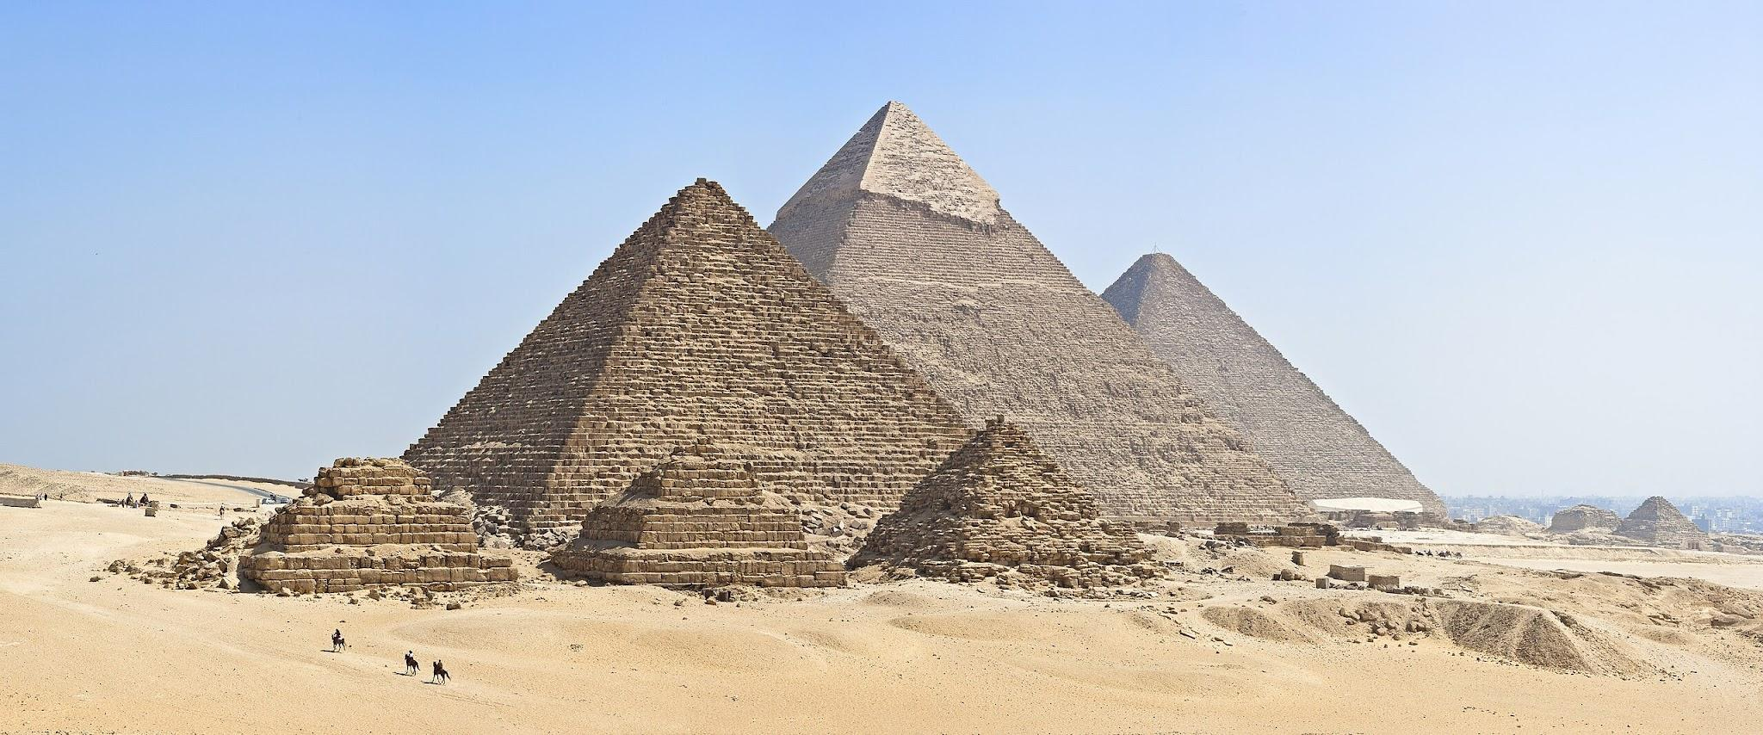
All about dynasty 12

Slide 2
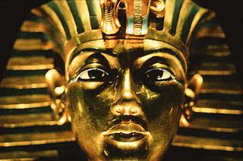
What happened in dynasty 12?
Firstly, Egyptian borders expanded significantly which was pushing into the Nubia and Levant.

Slide 3
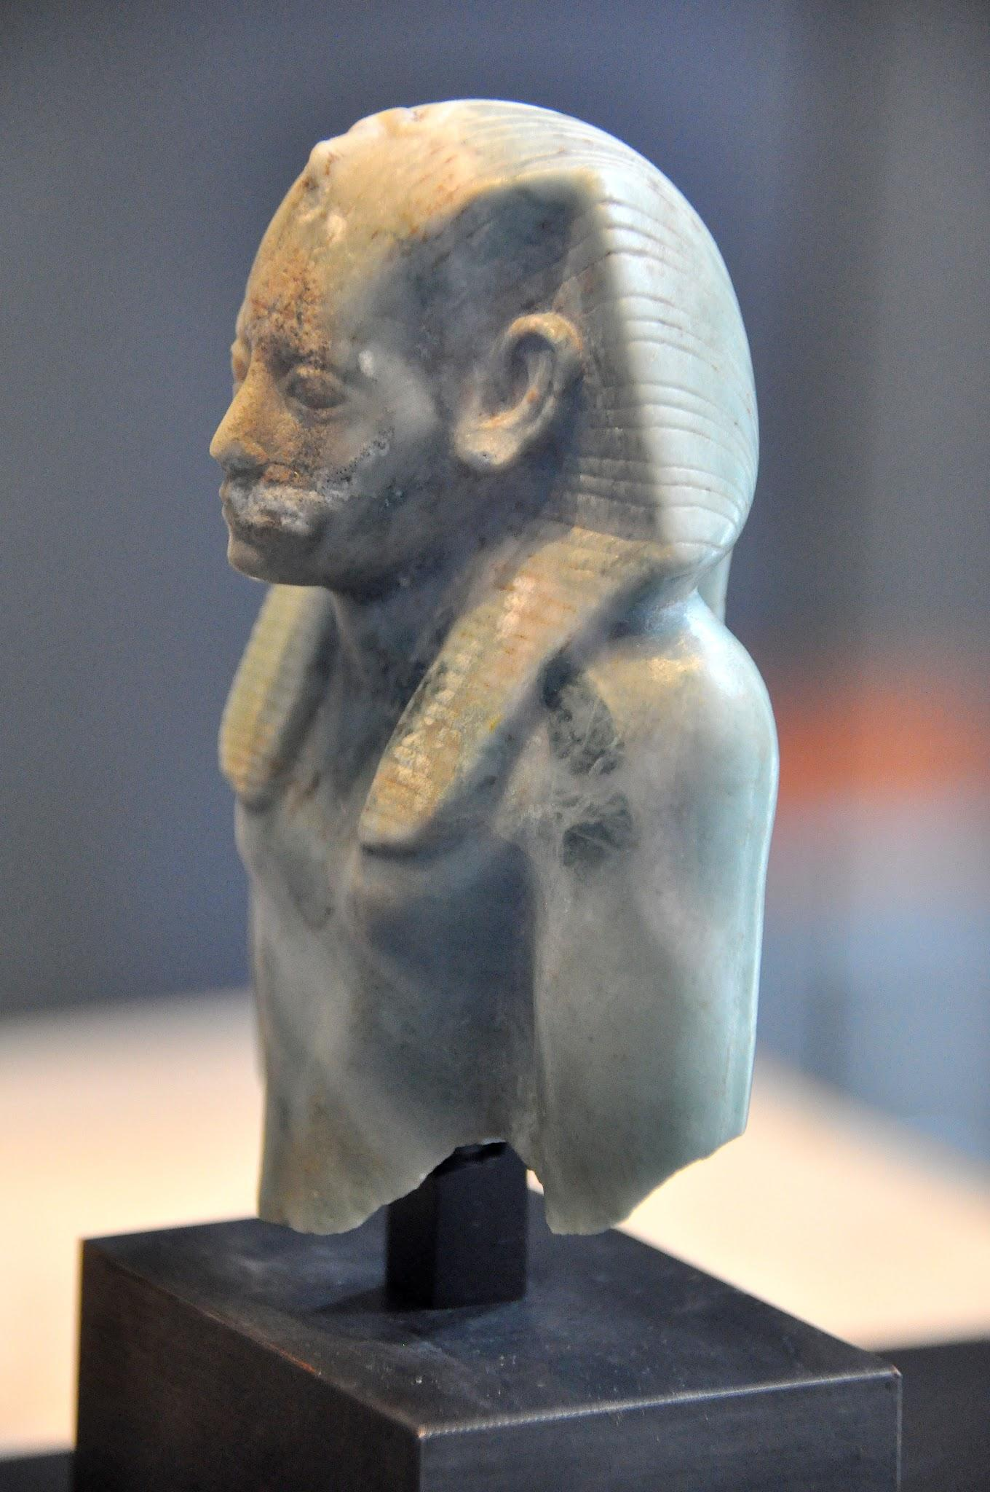
Who was the 12th dynasty pharaoh?
Sesostrist I was a king of ancient Egypt who succeeded his father after a ten-year coregency. He reigned for 48 years before being murdered.

Slide 4
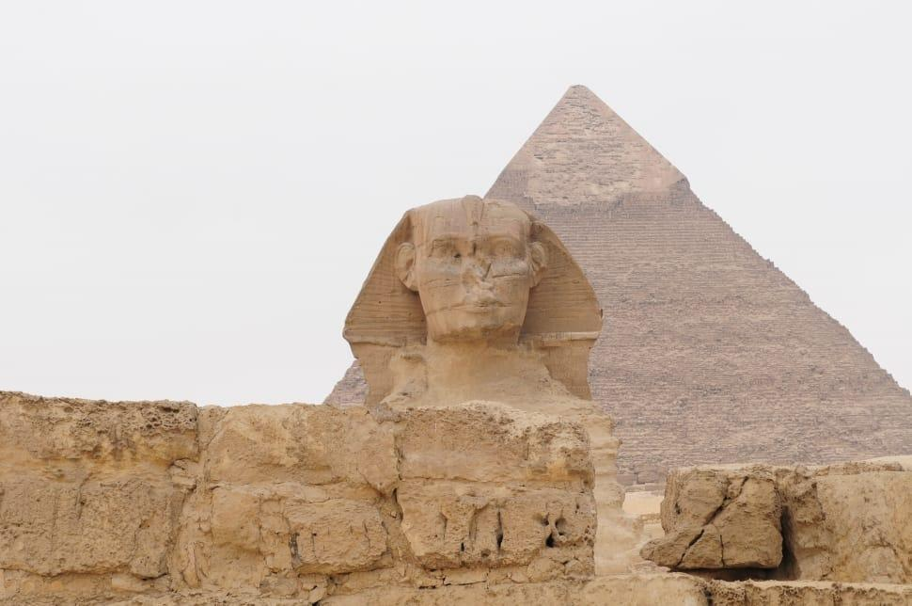
Significances
Lots of development in land mass and relative stability especially in politics. Also there was strong pharaohs.

Slide 5

THANK YOU
THANK YOU
FOR LISTENING

