Slide 1
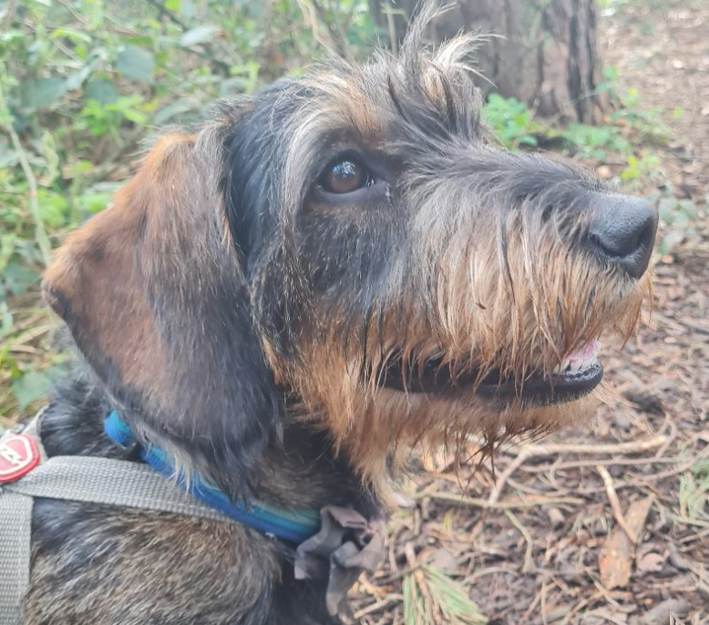
This is Murphy.
He is Mrs White’s Wirehaired Dachshund.
He is hoping to become Eureka’s Therapy dog and will hopefully come into school regularly to see you and work with some of the children.
He will have to do some training and pass a test to be a fully qualified therapy dog – so it’s just like him going to school to learn new things!

Slide 2
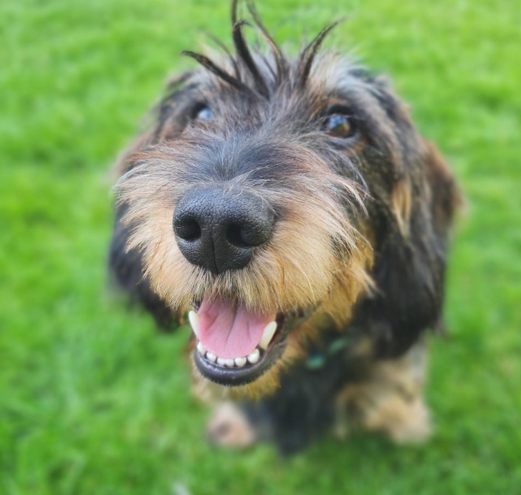
Murphy is 4 years old and has never been into a school before.
He might be a bit nervous because there are lots of you and he is quite small!
He will be visiting this week and we want to make him feel Happy, Safe and Comfortable in school, just like you!

Slide 3


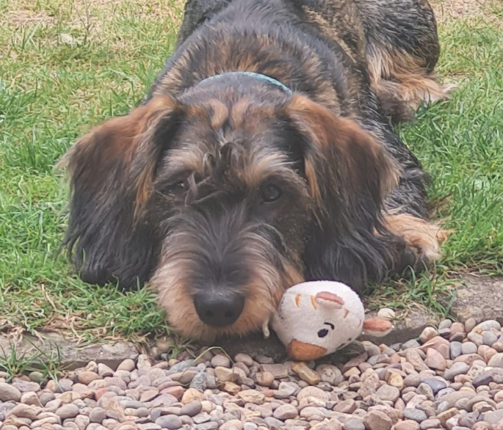
Ways to help Murphy feel happy when he is in school
DO
Be gentle with him
Be calm near him
Let him come to you
Remember he is not a toy!
Let him sniff you (its his way of saying hello!)
Do not stroke / pet him unless you have been told you can and an adult is present
DON’T
Rush up to him or run towards him
Make loud noises (even if he is really cute and exciting!!)
Crowd around him
Poke him
Try to hug or kiss him
Disturb him if he is sleeping

